Slide 1
Topic 9 Steady-Flow Devices (cont.)
Thermodynamics: An Engineering Approach
8th Edition Yunus A. Çengel, Michael A. Boles
McGraw-Hill, 2015

Slide 2
Objectives
Solve energy balance problems for common steady-flow devices such as throttling valves, mixers, heaters, and heat exchangers.

Slide 3

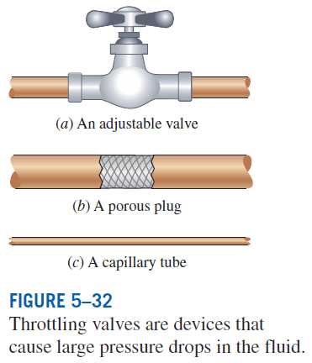

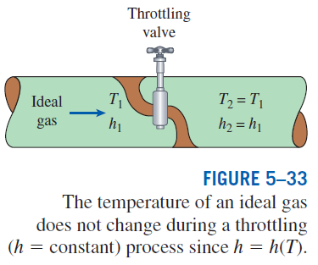
Throttling valves
Throttling valves are any kind of flow-restricting devices that cause a significant pressure drop in the fluid.
What is the difference between a turbine and a throttling valve?
The pressure drop in the fluid is often accompanied by a large drop in temperature, and for that reason throttling devices are commonly used in refrigeration and air-conditioning applications.
Energy balance

Slide 4
Expansion of R-134a in a Refrigerator
R-134a enters the capillary tube of a refrigerator as a saturated liquid at 0.8 MPa and is throttled to a pressure of 0.12 MPa. Determine the quality of the R-134a at its final state and the temperature drop during the process.
Example 1

Slide 5
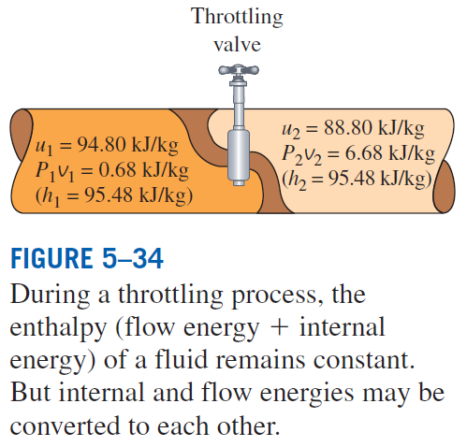


Expansion of Refrigerant-134a in a Refrigerator

Slide 6
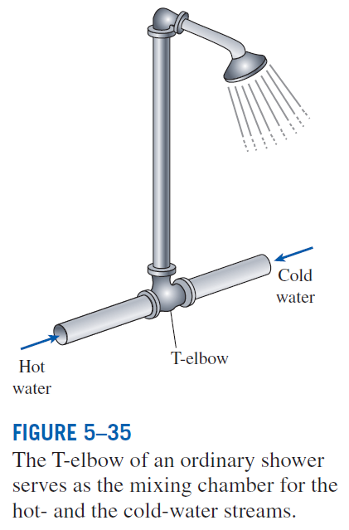
Mixing chambers
In engineering applications, the section where the mixing process takes place is commonly referred to as a mixing chamber.
The mixing chamber does not have to be a distinct “chamber.” An ordinary T-elbow or a Y-elbow in a shower, for example, serves as the mixing chamber for the cold- and hot-water streams.
The conservation of mass principle for a mixing chamber requires that the sum of the incoming mass flow rates equal the mass flow rate of the outgoing mixture.
The conservation of energy equation is analogous to the conservation of mass equation.

Slide 7
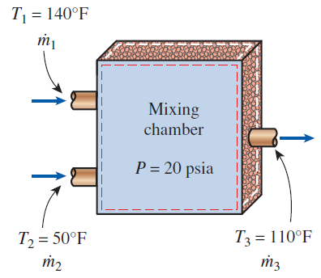
Mixing Hot and Cold Water in a Shower
In an ordinary shower, hot water at 140ºF is mixed with cold water at 50ºF. The desired temperature of the water stream leaving the shower head is 110ºF. Assuming there is no heat loss and the mixing takes place at a pressure of 20 psia, determine the mass flow rate ratio of hot to cold water.
Example 2

Slide 8
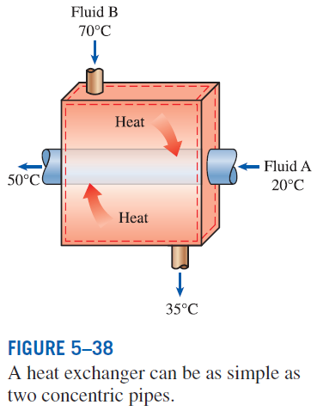
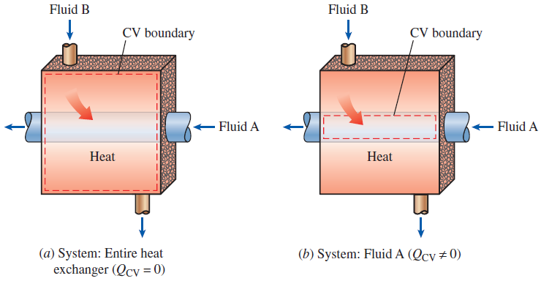
Heat exchangers
Heat exchangers are devices where two moving fluid streams exchange heat without mixing.
Heat exchangers are widely used in various industries, and they come in various designs.
The heat transfer associated with a heat exchanger may be zero or nonzero depending on how the control volume is selected.

Slide 9
Cooling of R-134a by Water
R-134a is to be cooled by water in a condenser. R-134a enters the condenser with a mass flow rate of 6 kg/min at 1 MPa and 70ºC and leaves at 35ºC. The cooling water enters at 300 kPa and 15ºC and leaves at 25ºC. Assuming the pressure drop is negligible, determine the mass flow rate of the cooling water and the rate of heat transfer from R-134a to the water.
Example 3

Slide 10
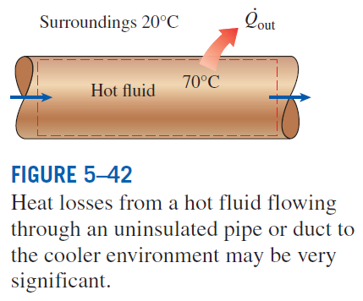
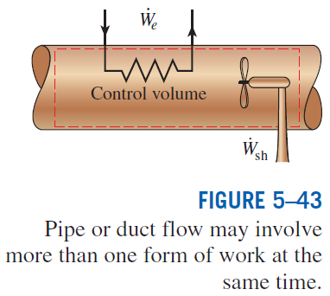
Pipe and duct flow
The transport of liquids or gases in pipes and ducts is of great importance in many engineering applications.
Flow through a pipe or a duct usually satisfies the steady-flow conditions.

Slide 11
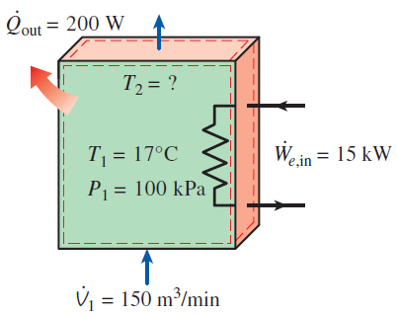
Electrical Heating of Air in a House
The electrical heating systems used in many houses consist of a simple duct with resistance heaters. Air is heated as it flows over the resistance wires. Consider a 15-kW electric heating system where air enters at 100 kPa and 17ºC with a flow rate of 150 m³/min. If the rate of heat loss from the air duct to the surroundings is 200 W, determine the final temperature of the air.
Example 4

Slide 12
Summary
Some steady-flow engineering devices
Mixing chambers and Heat exchangers
Pipe and Duct flow

